Slide 1

Vivekanand Education Society’s Institute Of Technology
Master of Computer Applications
Project Review I
Title : VisiMark - Intelligent Facial Attendance Tracker
Domain: Computer Vision and Biometrics
Group Members:
Member 1 : Gautam Shrinivasan
Member 2 : Pushkar Sane
Member 3 : Anuj kadam
Mentor Name : Dr Dhanamma Jagli

Slide 2
Content
Introduction to the project
Problem Statement
Objectives of the project
Requirements of the system (Hardware, Software)
System Design
Front End
Implementation
Gantt Chart
Conclusion
References

Slide 3
Introduction to Project
In the modern educational landscape, "VisiMark" offers a groundbreaking solution to the challenges of attendance management at VESIT. This automated system replaces time-consuming and error-prone manual methods with advanced technology, including facial recognition and machine learning algorithms. By doing so, “VisiMark” enhances efficiency and ensures a seamless experience for both students and administrators.
The project comprises two vital components: a user-friendly frontend and a sophisticated backend. The frontend provides an intuitive interface for students to access their attendance records and allows administrators to effortlessly manage attendance data. The backend component integrates complex logic, such as facial recognition algorithms, with the existing VESIT database system, ensuring a robust and comprehensive solution.
For students, “VisiMark” eliminates the need for manual attendance sign-ins and paper-based records. Facial recognition technology marks attendance in real-time, reducing the possibility of errors or manipulation. Administrators benefit from automated record-keeping and comprehensive reporting, gaining deeper insights into student engagement and attendance patterns.
In conclusion, the "VisiMark" project introduces an automated attendance management system tailored for VESIT. By harnessing advanced technologies and providing a seamless user experience, the project aims to revolutionize attendance tracking, streamline processes, and improve accuracy, ultimately contributing to an efficient and effective educational environment at VESIT.
r Rates

Slide 4
Problem Statement
In educational institutions like VESIT (Vivekanand Education Society’s Institute of Technology), the traditional methods of attendance management present various challenges. Manual attendance tracking through roll-calls or signature-based systems is time-consuming, error-prone, and lacks efficiency. These methods often result in inaccurate attendance records, which can impact academic reporting and student engagement analysis. To address these challenges, the “VisiMark”; project aims to develop an automated attendance management system that revolutionizes the attendance tracking process and improves overall accuracy.
Colleges faces challenges in attendance management due to manual methods, which are labor-intensive and lead to delays, inconsistencies, and potential inaccuracies in recording and processing attendance data. This hinders teachers' ability to focus on instructional activities and administrators' ability to generate accurate reports. Additionally, manual attendance tracking methods lack reliability and can be easily manipulated, compromising data integrity and hindering the institution's ability to assess student engagement and make informed decisions.
To address these challenges, the “VisiMark” project proposes the development of an automated attendance management system. By leveraging advanced technologies such as facial recognition and machine learning, the system aims to streamline attendance tracking, improve accuracy, and simplify administrative tasks. The system will automate the attendance marking process, eliminate the need for manual intervention, and provide real-time and reliable attendance records.
r Rates

Slide 5
Objectives of the project
Automate Attendance Tracking: Develop a system that automates the process of recording student attendance to eliminate manual effort and reduce errors commonly associated with traditional attendance tracking methods.
Improve Efficiency: Enhance administrative efficiency by streamlining attendance management processes and providing real-time attendance recording capabilities.
Ensure Accuracy and Reliability: Utilize facial recognition technology to ensure accurate identification and verification of students, minimizing the chances of fraudulent attendance records.
Enhance Data Management: Implement a robust database system to store and manage student details, attendance records, and related information for easy retrieval and analysis.
Simplify User Interaction: Create a user-friendly GUI that allows teachers and administrators to easily interact with the system, record attendance, and access attendance records.
Increase Security: Incorporate appropriate security measures to protect student data and ensure privacy, such as encryption techniques and access controls.
Facilitate Reporting: Enable the generation of comprehensive attendance reports, including student-wise attendance summaries, percentage calculations, and trends analysis, to assist in decision-making and monitoring attendance patterns.

Slide 6
Requirements of the system (Hardware, software)
Hardware Requirements -
Computer : You will need a computer or server to run the Python code.
Webcam : A high-resolution webcam is required for capturing facial images. Most built-in laptop webcams or external webcams will work.
GPU : If you plan to use deep learning models for facial recognition, having a GPU (Graphics Processing Unit) can significantly accelerate model training and inference. NVIDIA GPUs are commonly used for deep learning tasks.
Software Requirements -
Operating System : The project is compatible with Windows 10, macOS, and Linux.
Python : The project is developed in Python 3.7. It is recommended to create a virtual environment for managing Python packages.
Development Environment : The code is written and tested in Visual Studio Code, a popular and user-friendly Python IDE.
Libraries & Frameworks : OpenCV (version 4.5.2) for image processing and webcam access, Dlib (version 19.22.0) for facial detection and landmarks.

Slide 7
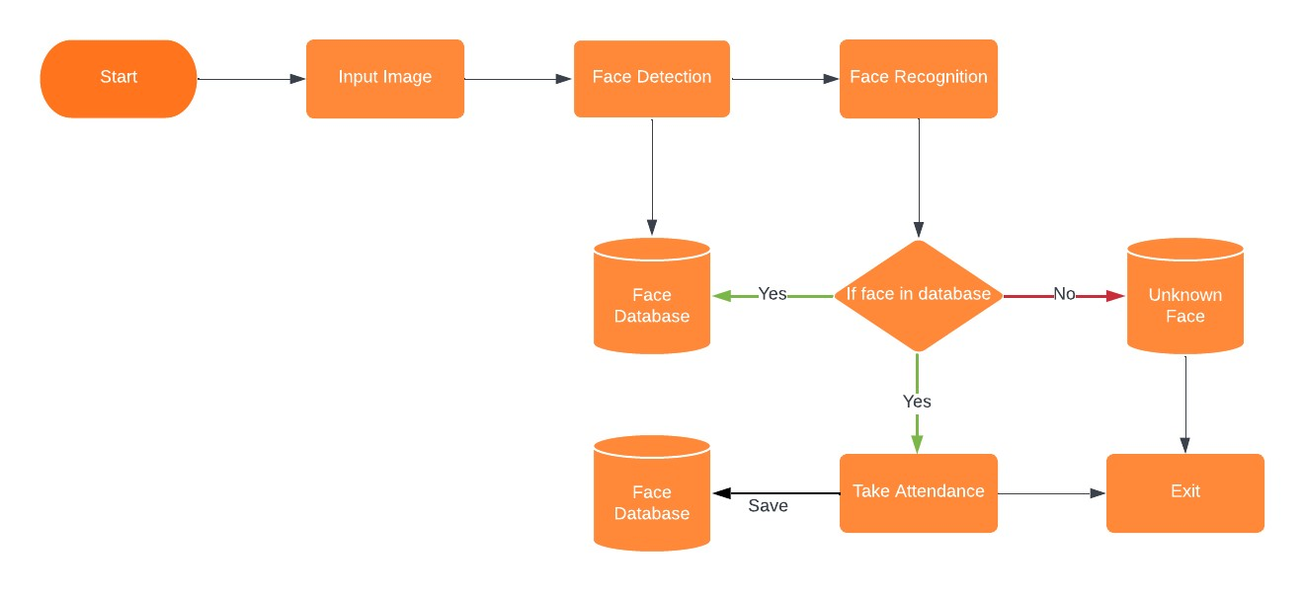
System Design of the proposed system

Slide 8
Front End
User Interface Design and Layout: The UI will be meticulously crafted to offer an intuitive and seamless experience for users. Special focus will be given to the arrangement and visual hierarchy of elements, guaranteeing a clear and user-friendly layout. This approach will enhance the user experience, making it more student-oriented and professional
GUI Component Implementation: In this project, various GUI components, including buttons, input fields, dropdown menus, and displays, will be implemented using ReactJS. Each component will be customized with the appropriate attributes, such as size, color, font, and positioning, to align with the overall design and functionality requirements.
Integration with OpenCV Algorithms: The frontend will seamlessly integrate with OpenCV algorithms for real-time face detection and recognition. Video frames from the webcam or user-provided images will be processed, allowing the system to identify faces through the face detection algorithm. Recognized faces will be matched against database records using face recognition algorithms, with real-time results displayed on the UI.
Event handling and User interactions: Event-driven programming techniques will be employed to efficiently handle user interactions. Event handlers will capture and respond to actions like button clicks, input changes, and menu selections. These interactions will trigger system functionalities such as image capture, face detection, and attendance record display.

Slide 9
Implementation
The implementation phase of the project involves the development and integration of both the frontend and backend components. The frontend development focused on creating an intuitive and visually appealing user interface using ReactJS. Various GUI components, will be implemented to facilitate user interactions and provide a seamless experience.
Additionally, a relational database will be integrated into the system to securely store student details and attendance records. The database facilitated efficient data management and retrieval, ensuring the accuracy and reliability of attendance tracking.
Throughout the implementation phase, rigorous testing and validation will be conducted to ensure the functionality, performance, and accuracy of the system. Real-time video streams and test cases will be used to verify the system’;s ability to detect faces, recognize individuals, and accurately record attendance.
The implementation phase also involves deployment of the system on the target environment, including installation and configuration steps. User training and documentation will be provided to familiarize users with the system’s features and functionalities. Ongoing support was offered to address user queries and feedback.
In this project, we will utilize advanced algorithmic methods to address challenges and meet project objectives. These algorithms play a key role in tasks such as facial recognition, data analysis, and pattern recognition, ensuring accuracy and system efficiency.

Slide 10
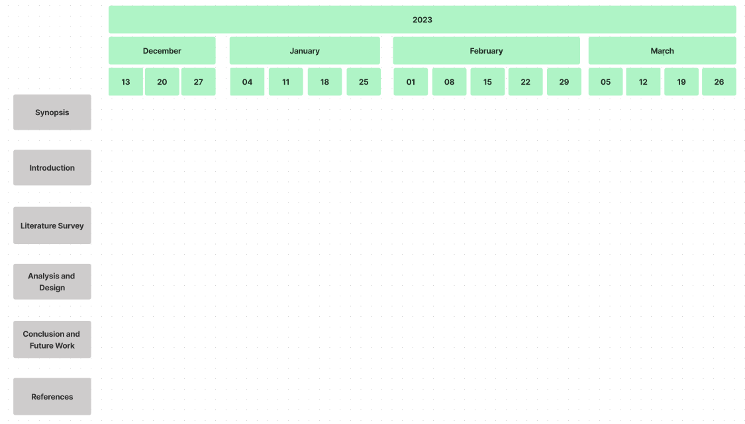
Gantt Chart
Notes:
The max flow algorithm in the visualization is :-

Slide 11
Conclusion
Overall, the "VisiMark: Intelligent Facial Attendance Tracker" project will represent a significant milestone in technology-driven attendance management solutions. It will offer an effective and efficient alternative to manual processes, simplifying administrative tasks, enhancing accuracy, and improving overall productivity. By embracing cutting-edge technologies and leveraging the power of computer vision, the project will pave the way for the future of attendance management in educational institutions and beyond. Additionally, future enhancements, such as refining the face detection and recognition algorithms, integrating advanced machine learning techniques, and expanding the system's functionalities, will unlock new possibilities and drive continuous improvement.
In conclusion, the "VisiMark: Intelligent Facial Attendance Tracker" project will showcase its effectiveness and potential in automating attendance management in educational institutions. The system's exceptional accuracy, real-time performance, user-friendliness, and advantages over manual systems will position it as a valuable asset for educational institutions looking to optimize administrative processes and enhance operational efficiency in the future.

Slide 12
References
J. W. S. D'Souza, S. Jothi and A. Chandrasekar, "Automated Attendance Marking and Management System by Facial Recognition Using Histogram," 2019 5th International Conference on Advanced Computing & Communication Systems (ICACCS), Coimbatore, India, 2019, pp. 66-69, doi: 10.1109/ICACCS.2019.8728399.
E. Varadharajan, R. Dharani, S. Jeevitha, B. Kavinmathi and S. Hemalatha, "Automatic attendance management system using face detection," 2016 Online International Conference on Green Engineering and Technologies (IC-GET), Coimbatore, India, 2016, pp. 1-3, doi: 10.1109/GET.2016.7916753.
H. Rathod, Y. Ware, S. Sane, S. Raulo, V. Pakhare and I. A. Rizvi, "Automated attendance system using machine learning approach," 2017 International Conference on Nascent Technologies in Engineering (ICNTE), Vashi, India, 2017, pp. 1-5, doi: 10.1109/ICNTE.2017.7947889.
https://opencv.org/about/
https://becominghuman.ai/face-detection-using-opencv-with-haar-cascade-classifiers-941dbb25177
https://pyimagesearch.com/2021/05/03/face-recognition-with-local-binary-patterns-lbps-and-opencv/
https://www.researchgate.net/publication/326261079_Face_detection_system_for_attendance_of_class'_students
https://www.javatpoint.com/face-recognition-and-face-detection-using-opencv

